Slide 1



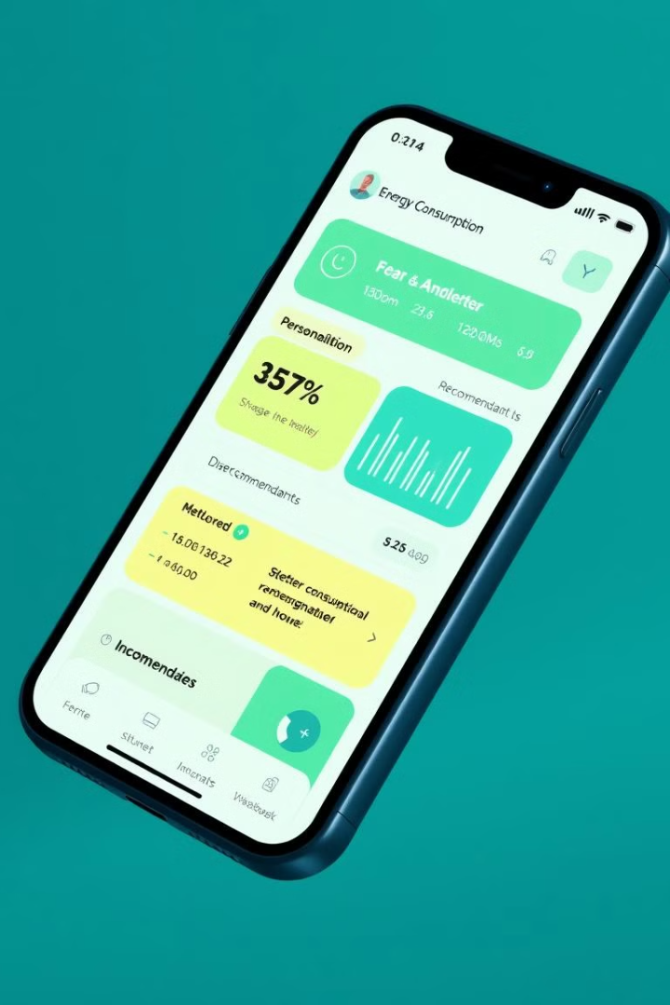
The Project Presented by
Syed Hammad Uddin Taji
1
SP22-BSCS-0023
Rafay Amir
2
SP22-BSCS-0051
Huzaifa Mustafa
3
SP22-BSCS-0046
Parallel Distributed Computing
Notes:
1

Slide 2
Real-Time Personalized Energy Optimization for Smart Grids Using Distributed Clustering
This presentation explores a novel framework for real-time personalized energy optimization in smart grids using distributed clustering techniques. By leveraging real-time data streams and clustering algorithms, the system dynamically adjusts energy usage patterns for individual consumers, reducing costs and enhancing grid efficiency.
Notes:
2

Slide 3
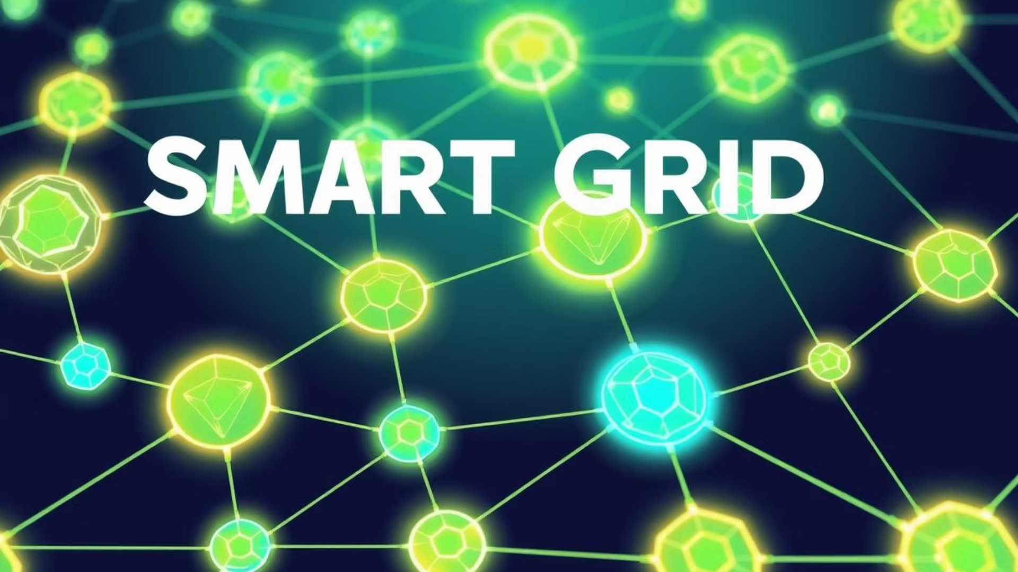

The Need for Personalized Energy Optimization
Traditional Limitations
The Power of Real-Time Data
Traditional energy optimization systems often focus on general strategies, overlooking individual consumer behaviors. This leads to inefficiencies in energy consumption and distribution.
The increasing adoption of smart grids and IoT devices has led to an explosion of real-time energy data, presenting significant opportunities for personalized energy optimization.
Notes:
3

Slide 4

Framework Design and Contributions
Distributed Data Processing
Parallel Optimization
The framework partitions the data across multiple nodes for parallel processing, significantly reducing computation time.
Energy optimization calculations are performed concurrently on different nodes, ensuring real-time responsiveness.
Scalability and Fault Tolerance
Real-time Feedback
The distributed architecture allows for seamless scalability and fault tolerance, ensuring the system remains robust and responsive even under high load or node failures.
The system facilitates real-time feedback loops between nodes, enabling dynamic adjustments to the optimization strategies based on changing conditions.
Notes:
4

Slide 5

Methodology: Data Collection, Preprocessing, and Clustering
Data Collection and Preprocessing
Distributed Clustering
Real-time energy data is collected from IoT-enabled devices, including smart meters and connected appliances. The preprocessing stage involves noise removal, handling missing values, and normalizing features for clustering.
Clustering forms the core analytical component of the framework, with two primary algorithms utilized: K-means Clustering and DBSCAN.
Notes:
5

Slide 6
Personalized Optimization and Consumer Insights
Recommendations
Alerts
The system provides recommendations for high-usage clusters to shift energy consumption to off-peak hours, thereby reducing costs and alleviating grid strain.
Alerts for anomalies, enabling prompt action to address potential issues such as equipment faults.
Adaptive Load Balancing
Adaptive load balancing strategies to ensure grid stability during periods of peak demand.
Notes:
6

Slide 7




Technologies and Tools: Enabling Real-Time Optimization
IoT for Data Collection
Data Streaming and Processing
IoT-enabled devices are essential for collecting real-time energy usage data.
Apache Kafka and Apache Flink are used for efficient data streaming and real-time processing.
Distributed Clustering Algorithms
Edge Computing for Low-Latency Processing
The system leverages clustering algorithms such as Apache Spark MLlib and Scikit-learn.
Edge computing technologies reduce latency by processing data at the source.
Notes:
7

Slide 8
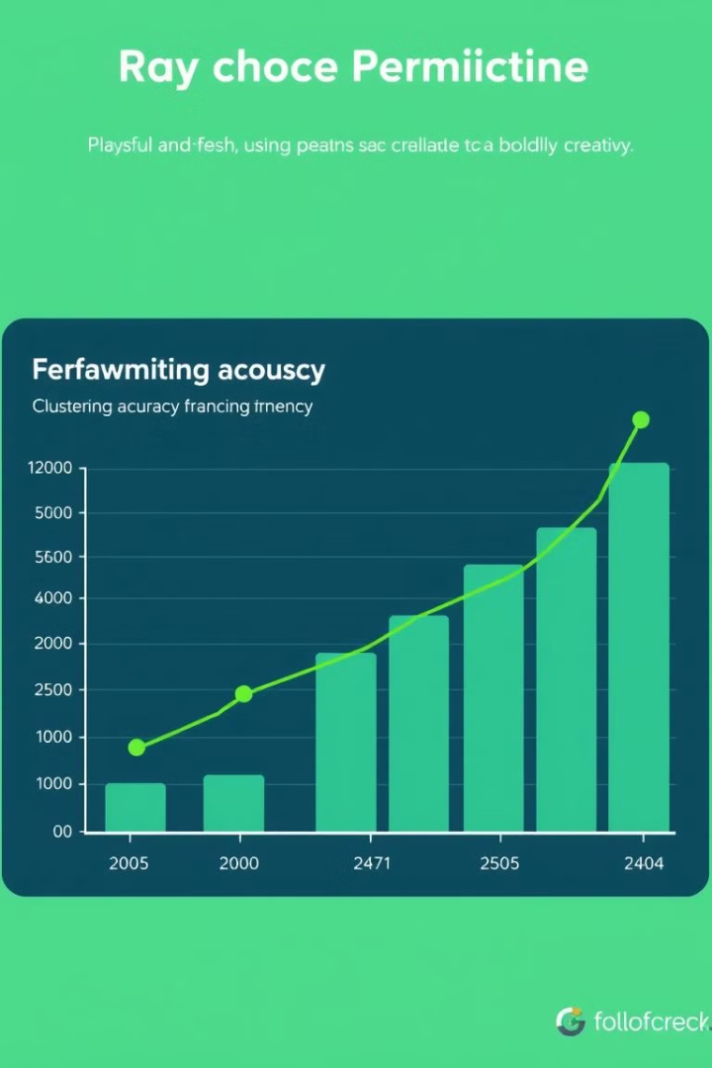
Results and Analysis: Demonstrating Framework Effectiveness
40%
25%
Energy Wastage Reduction
Consumer Cost Savings
A 40% reduction in grid-wide energy wastage, attributed to the tailored recommendations and anomaly detection capabilities.
A 25% improvement in consumer cost savings compared to traditional optimization systems, emphasizing the value of personalized insights.
Notes:
8

Slide 9

Conclusion and Future Directions
This research demonstrates the feasibility and effectiveness of distributed clustering techniques for real-time personalized energy optimization in smart grids. By leveraging real-time data streams and scalable algorithms, the proposed framework delivers actionable insights, enhancing grid efficiency and reducing consumer costs.
Future work aims to address the current limitations, further advancing the capabilities of smart grid technologies.
Notes:
9

